Slide 1
February 25th
Huntingtin function in HD
Therapeutic approaches in HD

Slide 2
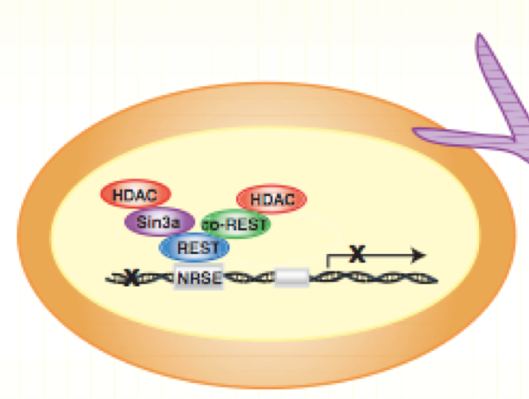
RE1-Silencing Transcription factor (REST), aka Neuron-Restrictive Silencer Factor (NRSF)

Slide 3
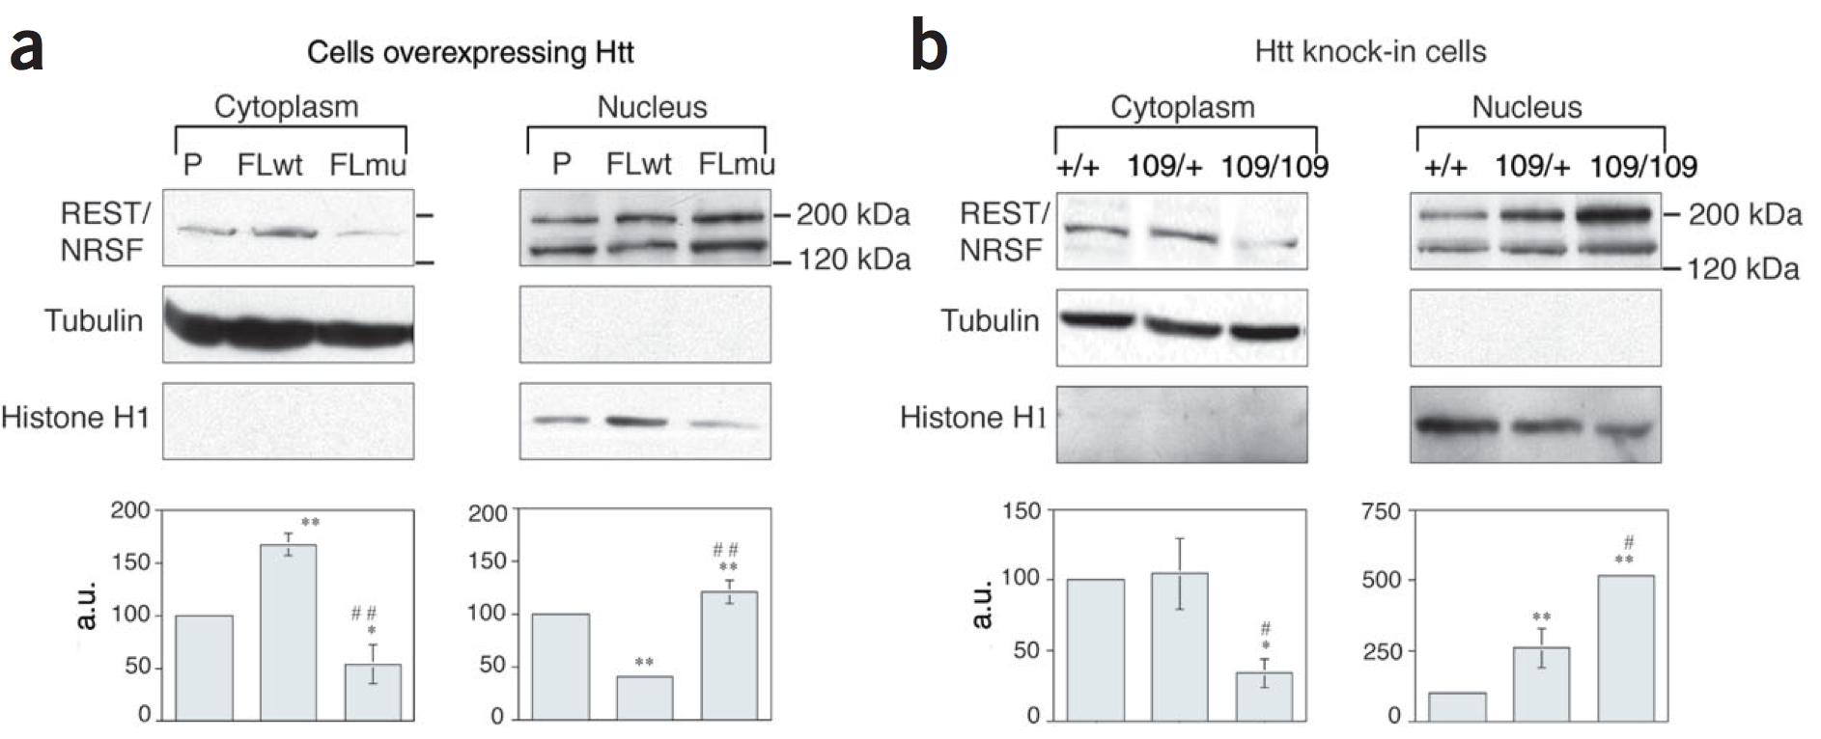
WT or mut HTT differently affect REST
intracellular localization
RE1-Silencing Transcription factor (REST), aka Neuron-Restrictive Silencer Factor (NRSF)

Slide 4
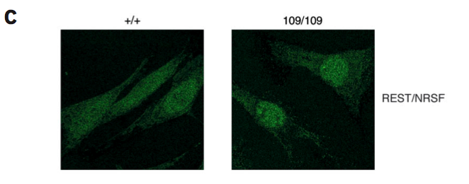
Mutant HTT redistributes REST to the nucleus

Slide 5
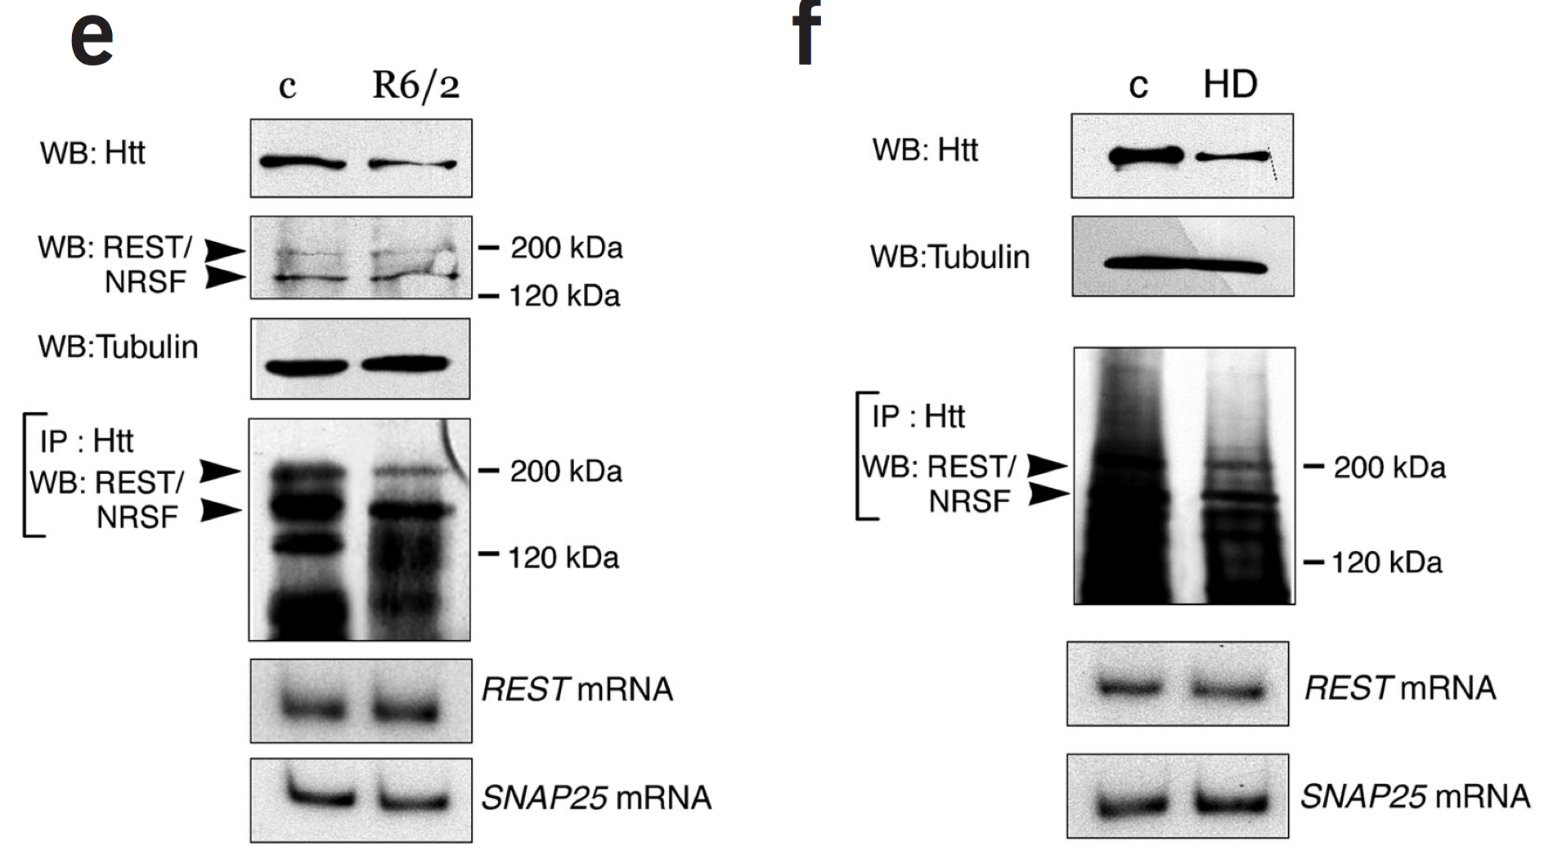
REST interacts with wt HTT in NON-HD cells.
In HD, REST interacts with HTT to a lesser extent.

Slide 6
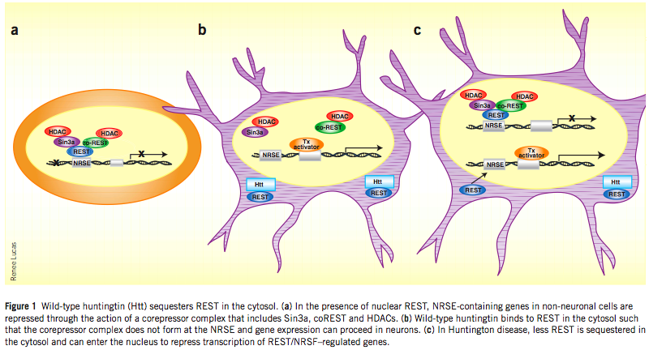
Wild type HTT sequesters REST in the cytosol
reducing its activity

Slide 7
Pathogenic mechanisms of mutant PolyQ huntingtin:
Mitochondrial dysfunction

Slide 8
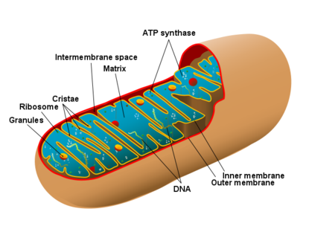
Membrane Potential: Difference in the voltage between the two sides of a membrane, caused by an influx and efflux of ions to and from a cell or neuron and an organelle. In the mitochondrion, the membrane potential is caused in particular by exchange of Ca⁺⁺ ions between the mitochondrion and the cytosol.
PTPs: Permeability Transition Pores
Ca⁺⁺
Ca⁺⁺
PTP

Slide 9
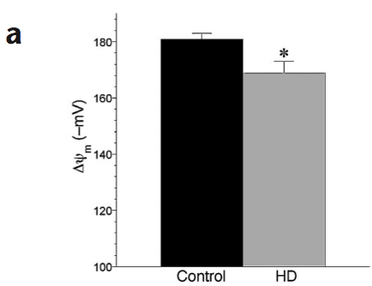
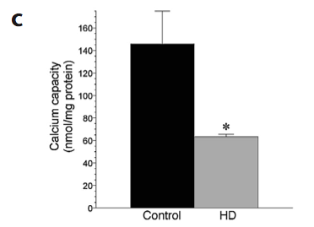
Membrane potential and calcium levels are reduced in HD mitochondria
Lymphoblasts
Panov et al., 2002

Slide 10
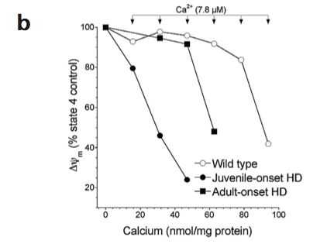
In HD patients, mitochondrial depolarization occurs
at lower Ca++ levels
PTP compromised?
Physiologically, the potential drops
when the PTP open
Juvenile HD patient: 65 repeats
Adult HD patient: 46 repeats
Panov et al., 2002

Slide 11
The tendency of the PTP to be open directly correlates with the number of PolyQ repeats in huntingtin mutant molecule

Slide 12
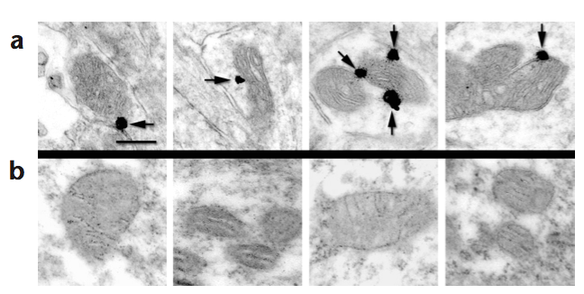
Huntingtin aggregates are visible on the mitochondrial membrane of PolyQ mutant huntingtin transgenic mice,
but not of wild-type huntingtin transgenic mice
Huntingtin PolyQ mutant transgenic mice
Huntingtin wild-type transgenic mice
Panov et al., 2002

Slide 13
Evidences that Calcium homeostasis is altered
1-in mitochondria of HD patients
2- in mitochondria of transgenic mice over-expressing mutant htt, but not in mice over-expressing wild type htt
3-administration of synthetic PolyQ repeats to human wild-type mitochondria in vitro causes alteration of calcium homeostasis
Altered PTP and mitochondrial calcium homeostasis EARLY EVENT in HD

Slide 14
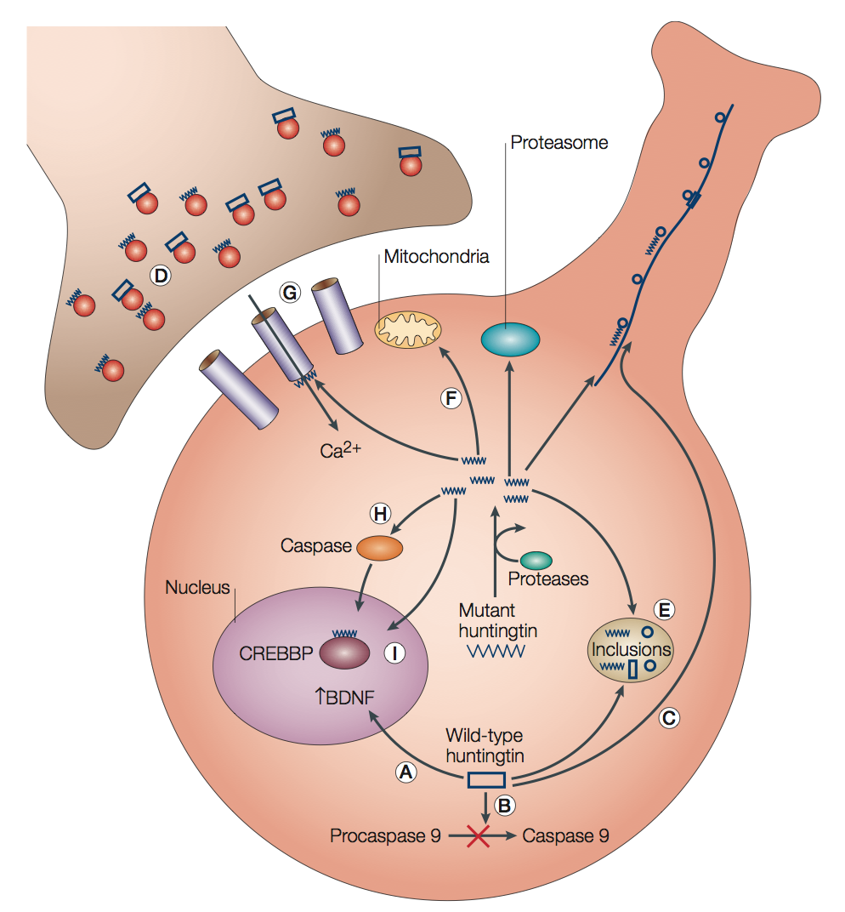
Mechanisms of toxicity of mutant huntingtin in HD
Notes:
Figure 3 | Mechanisms of toxicity in Huntington disease. Wild-type huntingtin is important for normal cellular development and has been proposed to be involved in transcriptional regulation of brain-derived neurotrophic factor (BDNF) (A), prevention of procaspase 9 cleavage (B), and transport (C) and release (D) of vesicles. Mutant huntingtin is cleaved by proteases and might disrupt cellular processes by various mechanisms: sequestration of normal cellular proteins that include wild-type huntingtin (E), mitochondrial dysfunction and oxidative stress (F), altered neurotransmitter release and receptor function (G), activation of caspases that initiate the apoptotic cascade (H), and interactions with nuclear factors that result in transcriptional dysregulation (I). Many of these mechanisms have become targets for therapeutic intervention. CREBBP, CREB-binding protein.

Slide 15
Mechanisms of gain of toxic function of mutant htt in HD

Slide 16
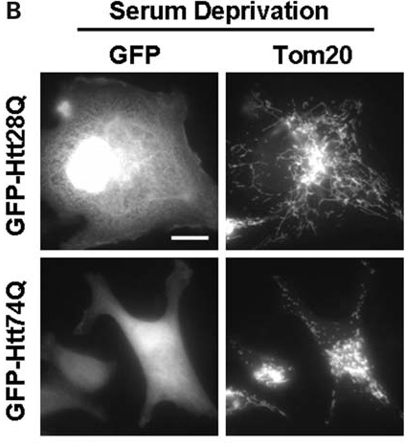
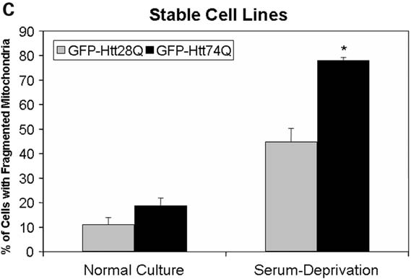
Serum deprivation increases mitochondrial fragmentation in cells over-expressing mutant htt
HeLa cells
Serum deprivation to induce oxidative stress

Slide 17
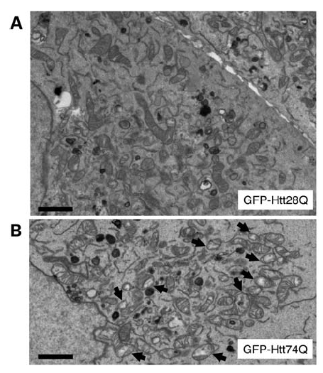
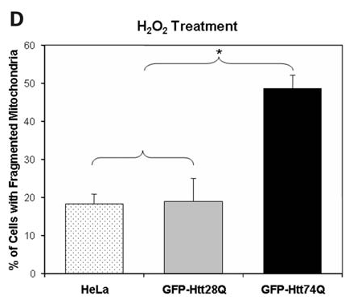
Mutant htt sensitizes cells to mitochondrial abnormalities following oxidative stress
30min

Slide 18
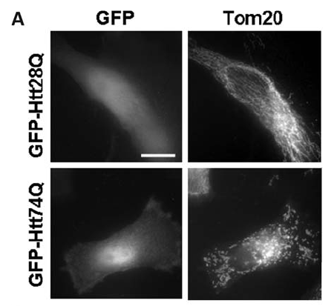
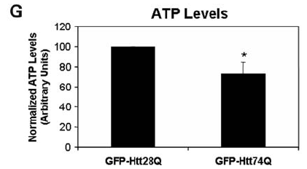
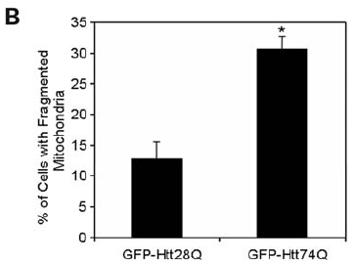
The only over-expression of toxic mutant htt causes mitochondrial fragmentation and dysfunction

Slide 19
Mutant htt affecting mitochondrial dynamics?

Slide 20
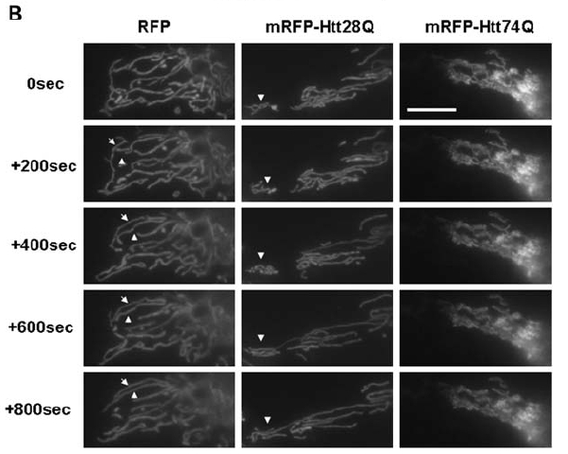
Mitochondrial fusion seems to occur only in cells
over-expressing wt htt, but not mutant htt

Slide 21
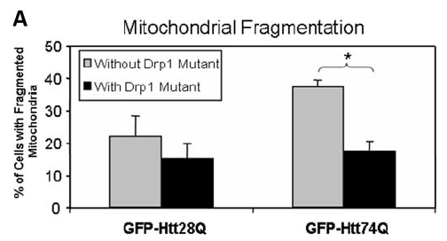
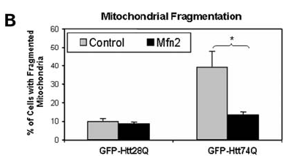
Abolishing fission (Drp1 mutant) or inducing fusion (Mfn2 expression) RESCUES the mitochondrial fragmentation phenotype
Cellular death by apoptosis caused by mutant htt is rescued too

Slide 22
Mutant htt PREDISPOSES cells to toxic stimuli leading to increased mitochondrial fission and therefore dysfunction
A role for unbalanced fusion/fission in mitochondrial dysfunction in HD?

Slide 23
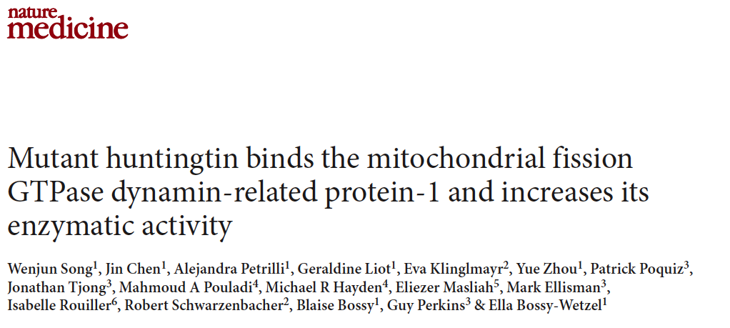

Slide 24
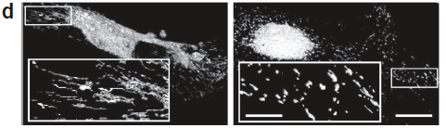
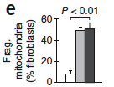
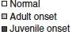
Mutant htt causes mitochondrial fragmentation
in fibroblasts of HD patients

Slide 25
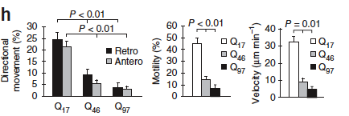
PolyQ expansion associated with HD impairs
mitochondrial movement

Slide 26
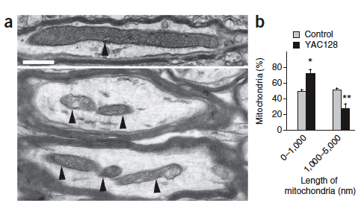
PolyQ expansion associated with HD affects mitochondrial size
WT
YAC128

Slide 27
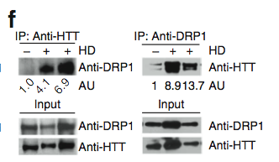
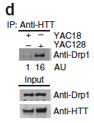
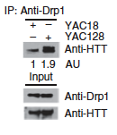
Mutant HTT associates with DRP1 in HD
Colocalization is also found in neurons
Human Brains
Mitochondrial lysates from mouse brain

Slide 28
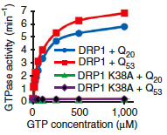
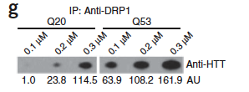
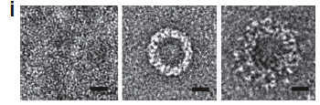
Mutant HTT has greater affinity than wt HTT for DRP1:
effects on DRP1 GTPase activity
DRP1 forms oligomers in presence of GTP (is a GTPase), even thicker in presence of mutant htt.
DRP1
No nucleotides
DRP1
+ nucleotides
DRP1
+ nucleotides
+httQ ^{ext1-53}

Slide 29
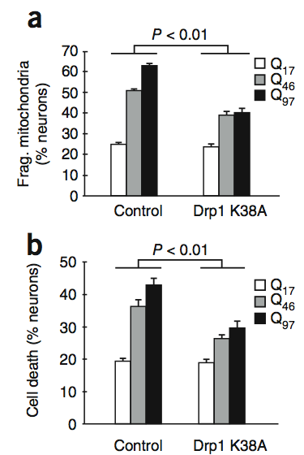
Inactive Drp1 mutant rescues the effects of polyQ htt
on mitochondrial fragmentation and cell death (and also transport)
Same effects achieved also by over-expression on Mfn2

Slide 30
Re-established mitochondrial fission and fusion balance improves the toxic effects of polyQ htt on mitochondrial motility, fragmentation and on cell death.

Slide 31
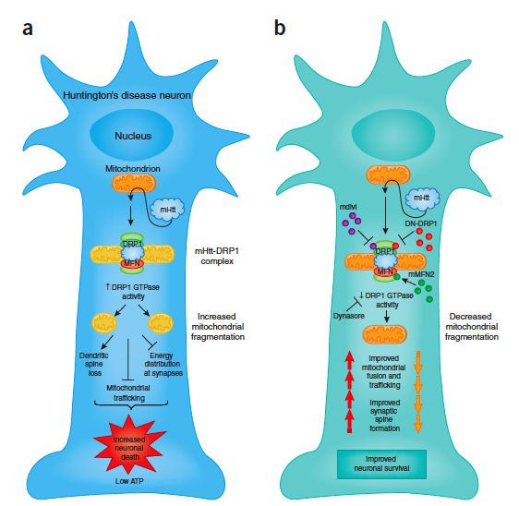
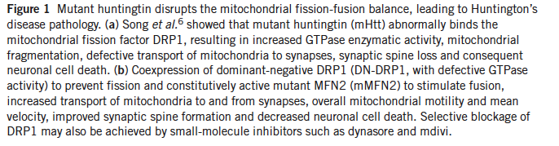
PolyQ htt binds to Drp1 and disrupts the equilibrium between
fission and fusion: a model for htt toxicity in HD

Slide 32
Autophagy in HD:
Loss of physiologic function of mutant htt

Slide 33
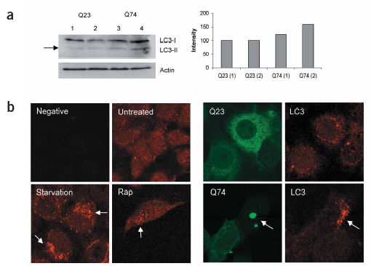
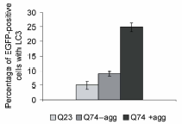
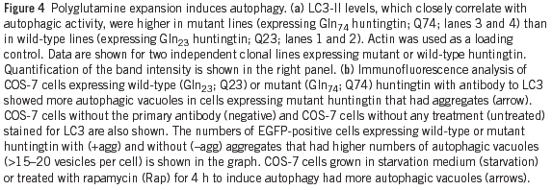
LC3II accumulates in HD: autophagy is induced or is defective?
COS-7

Slide 34
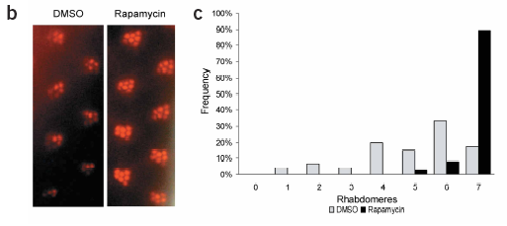
Rescuing autophagy with Rapamycin reverts the eye degenerating phenotype in htt mutant flies
Autophagy as a protective mechanism against HD

Slide 35
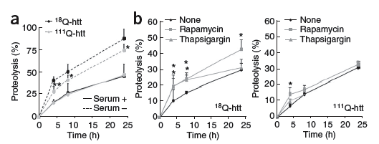
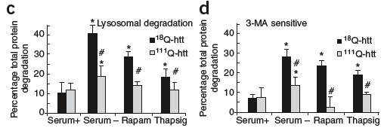
Autophagic activity is reduced in HD cells
Protein degradation in MEF from wt or mutant htt knock in mice
Thapsigarging:
Blocks fusion of autophagosomes with endocytic organelles

Slide 36
What happens at an autophagosome level?

Slide 37
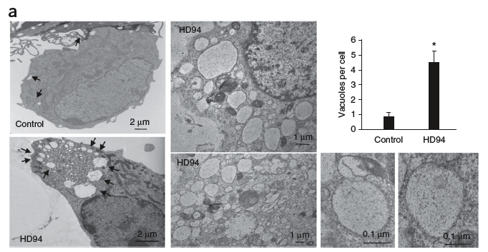
Autophagosomes are correctly formed and are abundant in HD cells
H O W E V E R . . . . . .

Slide 38
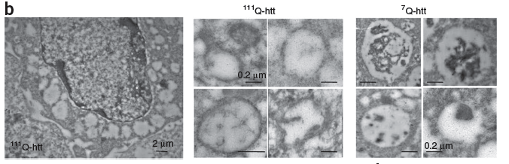
The cytosolic content in HD autophagosomes seems to differ from normal autophagosomes

Slide 39
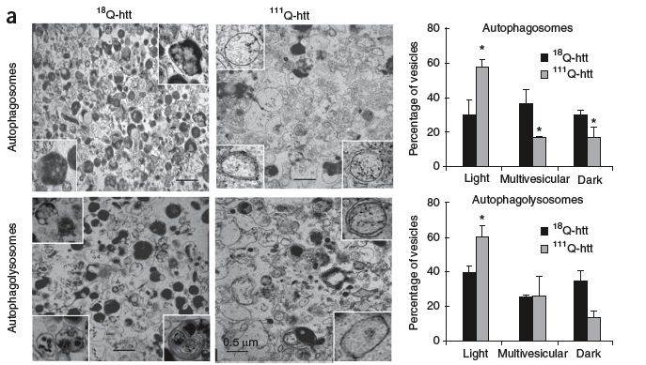
Inefficient engulfment of cytosolic components by autophagosomes in HD cells

Slide 40
Macroautophagy is inefficient in HD cells
Does the cell “give up” on autophagy in HD, or does it try to compensate with other mechanisms?

Slide 41
Therapy for HD
-Possible presymptomatic treatment, after genetic test.
-Symptomatic treatments aimed at treating:
Depression
Psychosis
Chorea
Tetrabenazine, depletes DA from central neurons.
-Mutant Htt siRNA
-Caspase inhibitors (risks of higher susceptibility to develop cancer after a long-term treatment). Minocycline (antibiotic already in use in humans) used now in clinical trails for HD. In HD prevents apoptosis by inhibiting caspases and mitochondrial permeability. Possible other unknown mechanisms of action.
-Enhancing the clearance of mutant Htt, for example by autophagy.
-NMDA receptors antagonists to block glutamate-induced excitotoxicity.
-To induce wt Htt physiological function

Slide 42
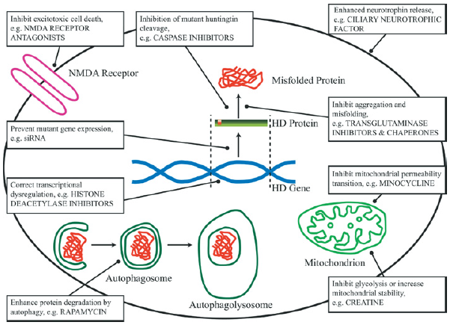
Potential therapeutic strategies in HD

Slide 43
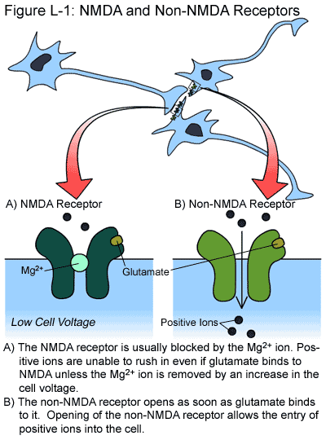
Excitotoxicity: How excess of Glutamate may trigger toxic mechanisms
http://web.stanford.edu/group/hopes/cgi-bin/wordpress/2011/06/about-glutamate-toxicity/

Slide 44
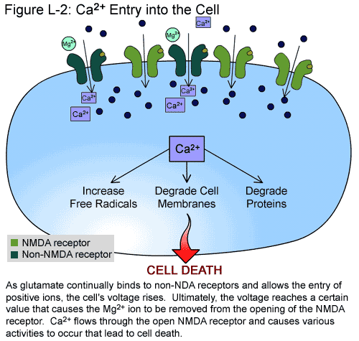
Increased Calcium entry secondary to changes in the membrane potential
http://web.stanford.edu/group/hopes/cgi-bin/wordpress/2011/06/about-glutamate-toxicity/

Slide 45
Wild type HTT sequesters REST in the cytosol reducing its activity
RE1/NRSE= Repressor Element1/neuron restrictive silencer element
Co-repressor platform

Slide 46
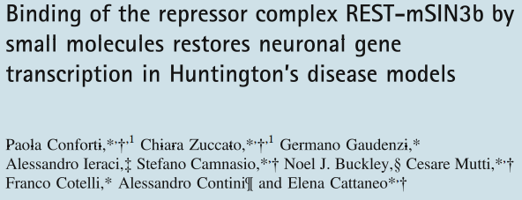

Slide 47
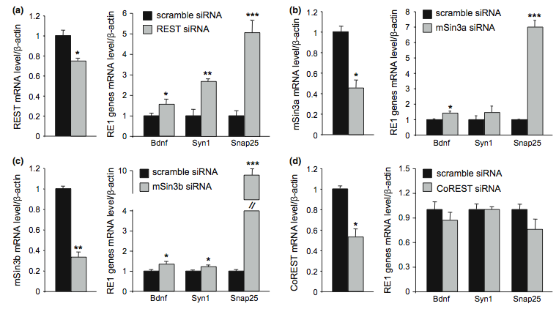
Knock Down of selective REST complex components positively influences neuronal gene transcription in HD cells

Slide 48


C91 stimulates endogenous BDNF transcription in HD cells (mut htt KI)

Slide 49

C91 redistributes mSIN3b out of the nucleus, to the cytosol

Slide 50
http://www.youtube.com/watch?v=KP7DaxZy7FY min 1

